Slide 1

Let Us Revise all the topics covered
Introduction to Python language
How to install Python and sublime text
Variable declaration and memory allocation
Built-in Python Datatypes
Python Operators

Slide 2
What is Conditional Statement
In a Python program, the if statement is how you perform this sort of decision-making. It allows for conditional execution of a statement or group of statements based on the value of an expression.

Slide 3
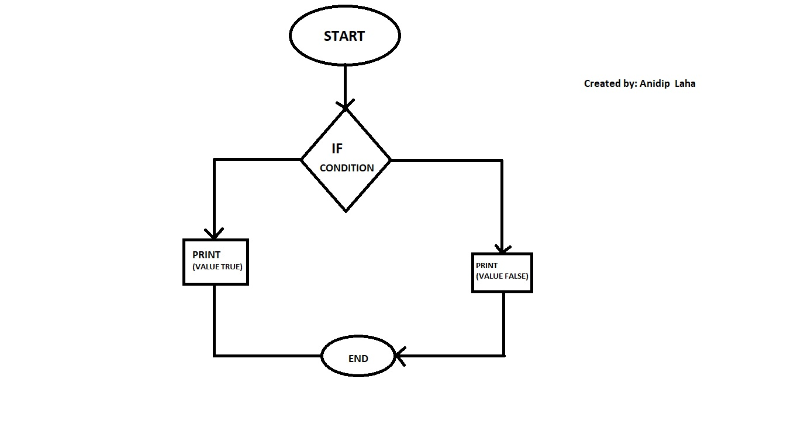
Python Conditional statements
There are three conditional statements in python.
1) if
2)elif
3)else
Take a look at the following DFD

Slide 4
If Statement
If is decision making statement, we have to mention the logical expression after if statement.
We can use multiple if statement inside the program, this is called nested if.

Slide 5
elif and else Statement
If we have multiple conditions inside a same expression we can use elif statement.
Multiple elif statement can be used if we have more than one conditions.
else statement must be at last.
Let us see some examples of Conditional Statements

Slide 6
Python Loops

Slide 7
Loops
Loops
Entry Control Loops
For Loop
Exit Control Loops
Do While Loop
While Loop
Not Possible in Python

Slide 8
For Loop
for-loop or for loop is a control flow statement for specifying iteration. Specifically, a for loop functions by running a section of code repeatedly until a certain condition has been satisfied.
For-loops have two parts: a header and a body. The header defines the iteration and the body is the code that is executed once per iteration. The header often declares an explicit loop counter or loop variable. This allows the body to know which iteration is being executed. For-loops are typically used when the number of iterations is known before entering the loop. For-loops can be thought of as shorthand's for while-loops which increment and test a loop variable.
Lets Take a look at some examples of For Loop

Slide 9
While Loop
The while construct consists of a block of code and a condition/expression. The condition/expression is evaluated, and if the condition/expression is true, the code within all of their following in the block is executed. This repeats until the condition/expression becomes false. Because the while loop checks the condition/expression before the block is executed, the control structure is often also known as a pre-test loop. Compare this with the do while loop, which tests the condition/expression after the loop has executed.
Lets Take a look at some examples of While Loop

Slide 10
Thank You very much for attending this presentation
If you have any question you are free to ask

